Slide 1


Online Shopping System
|
Moatsem Emam Hussain mahmoud
SCI CS - Ain Shams

Slide 2

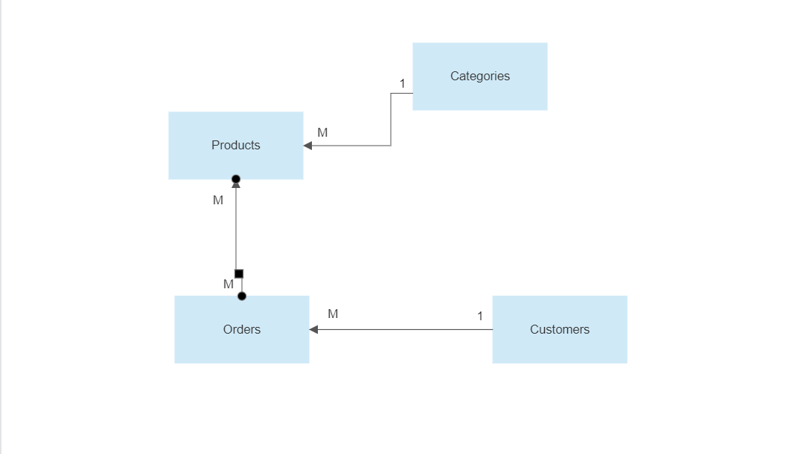
ModelDiagram

Slide 3
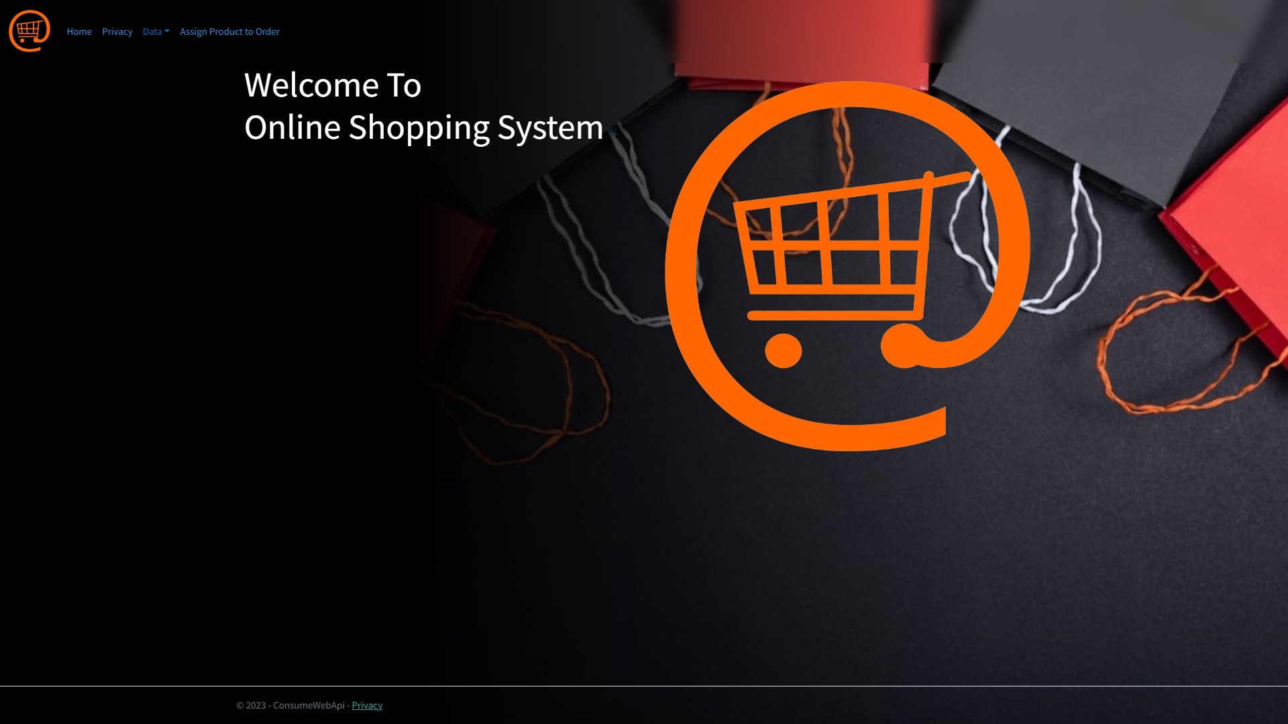
Home
Page:

Slide 4
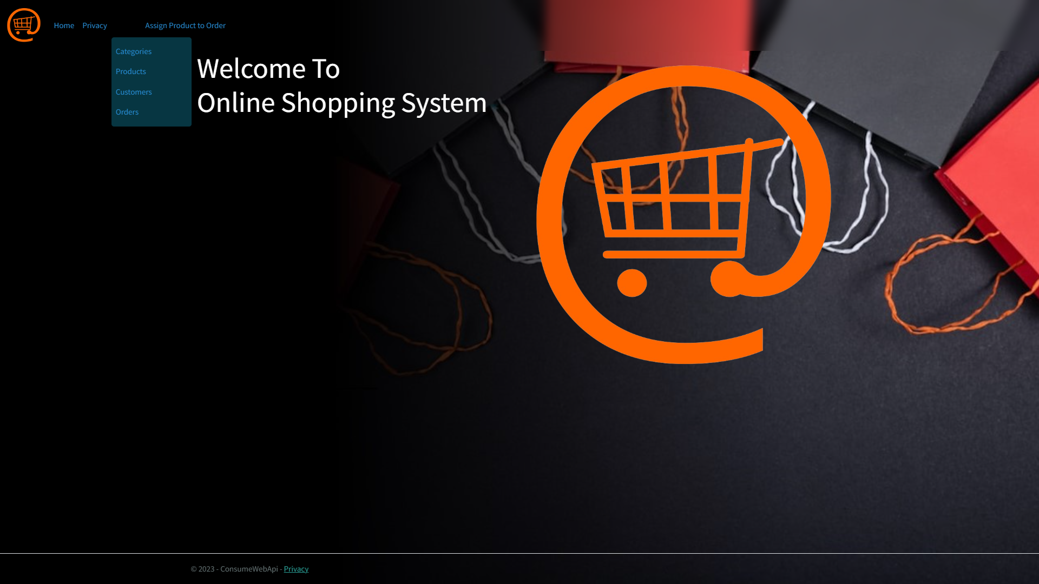
Home
Page:
As you can see this is the dropdwn list within it the data records.

Slide 5
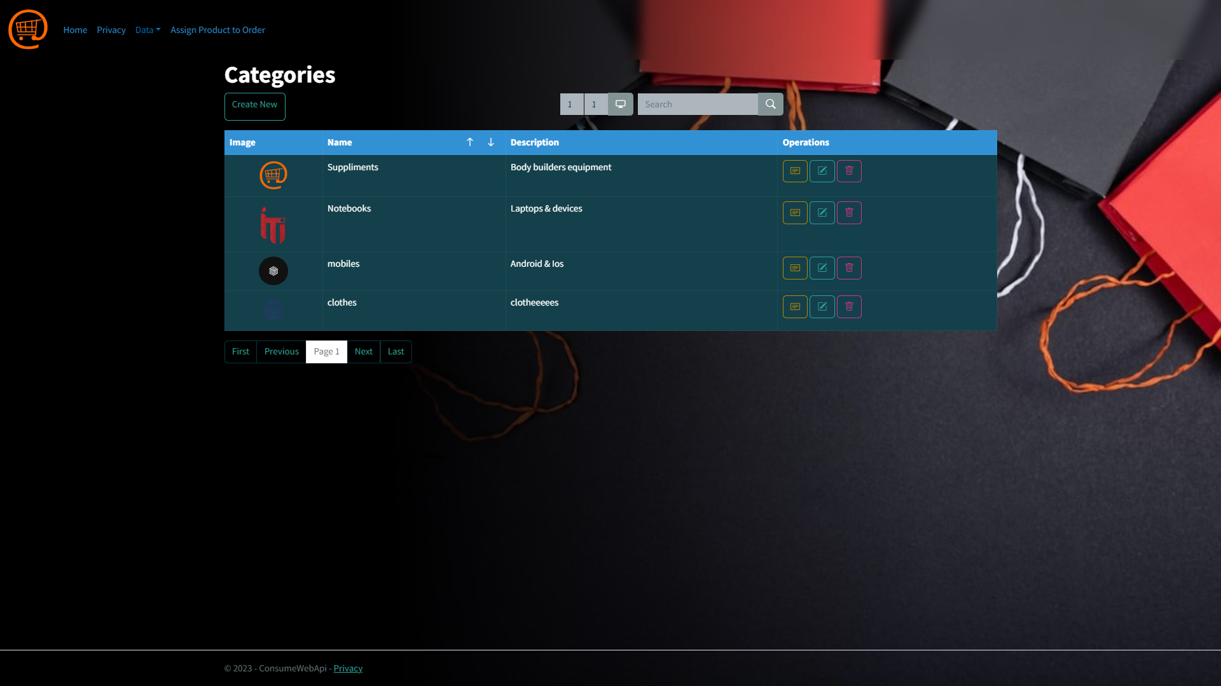
Category
Page:

Slide 6
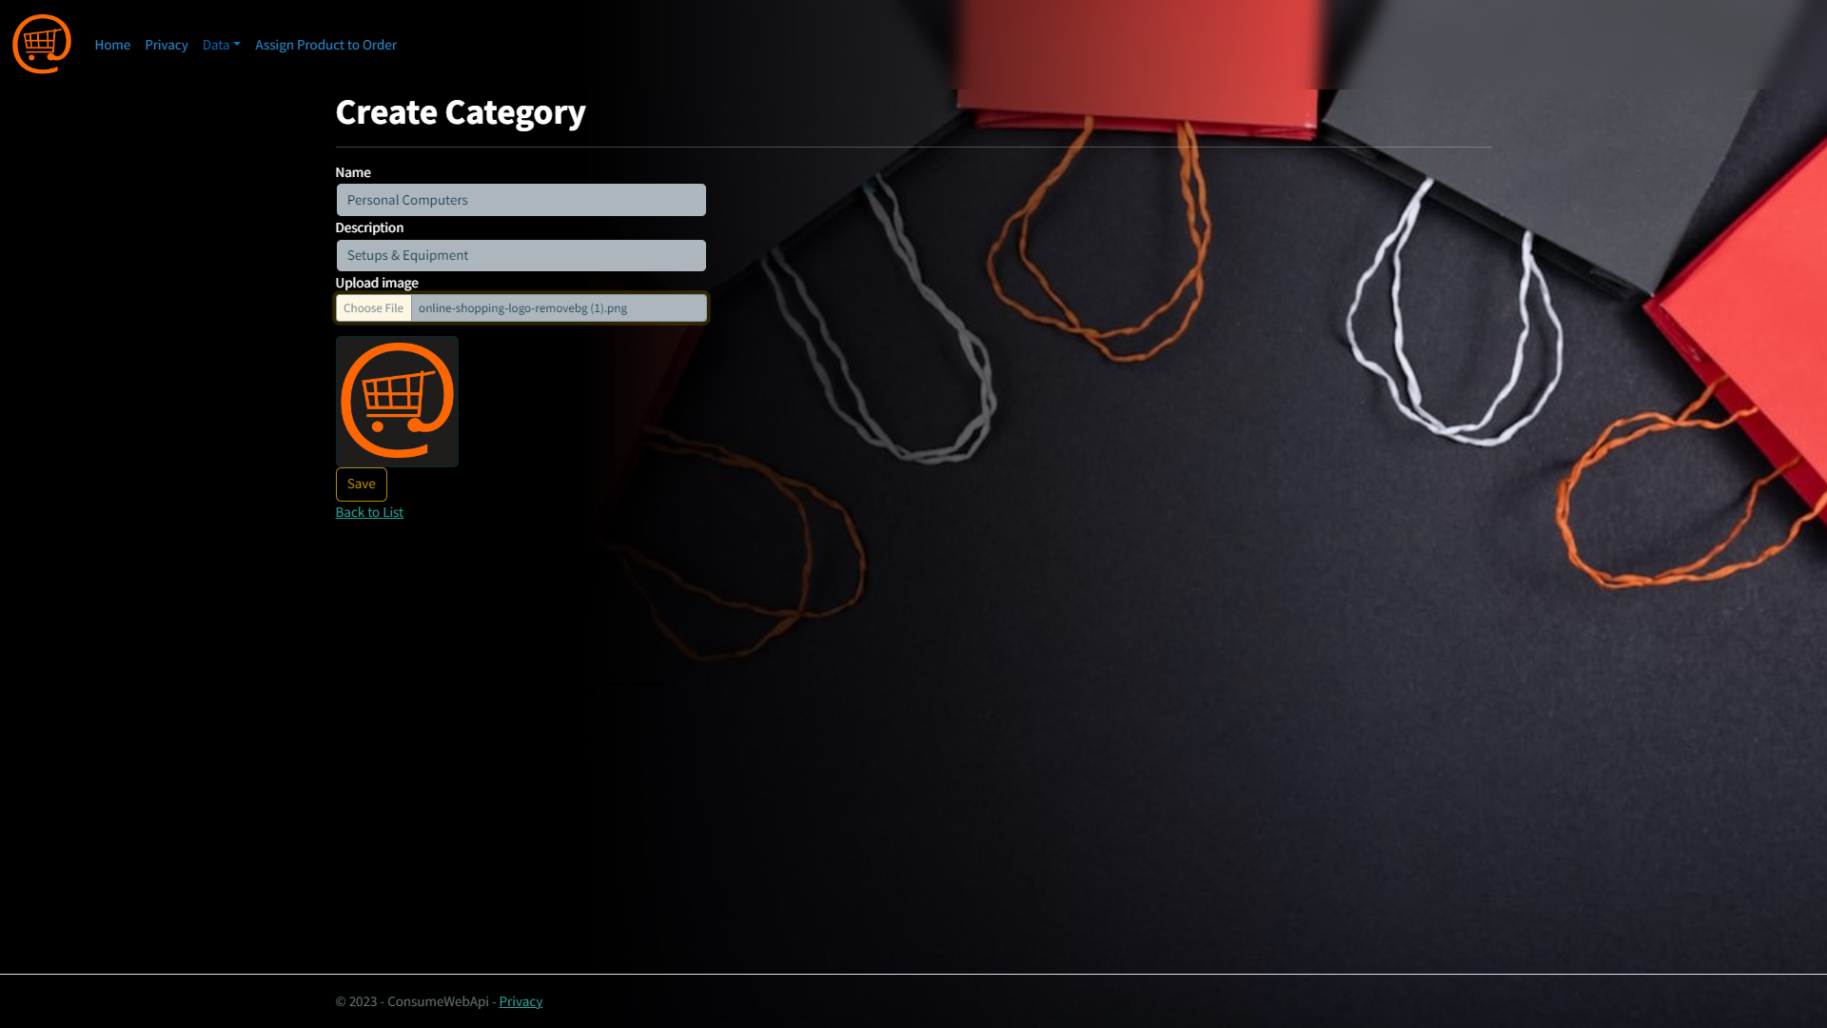
Create
Page:
You can create categories from here

Slide 7
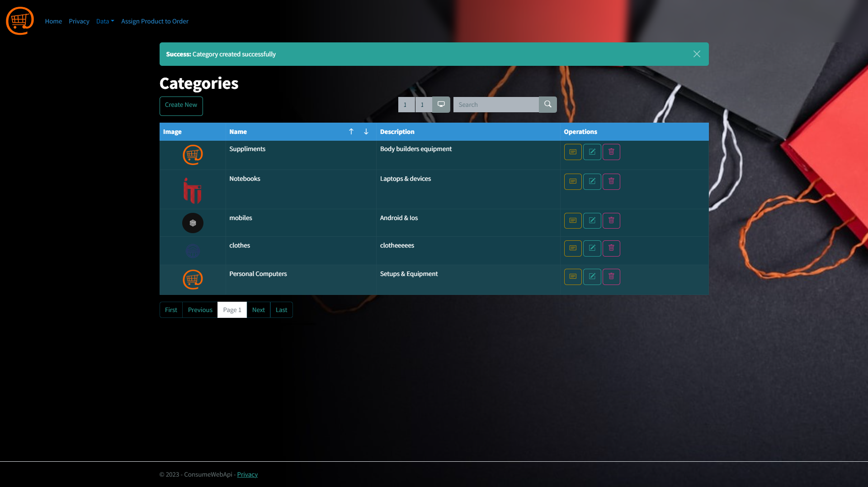
Category
Page:
After Creation, the message with succsses statement Is appeared.

Slide 8
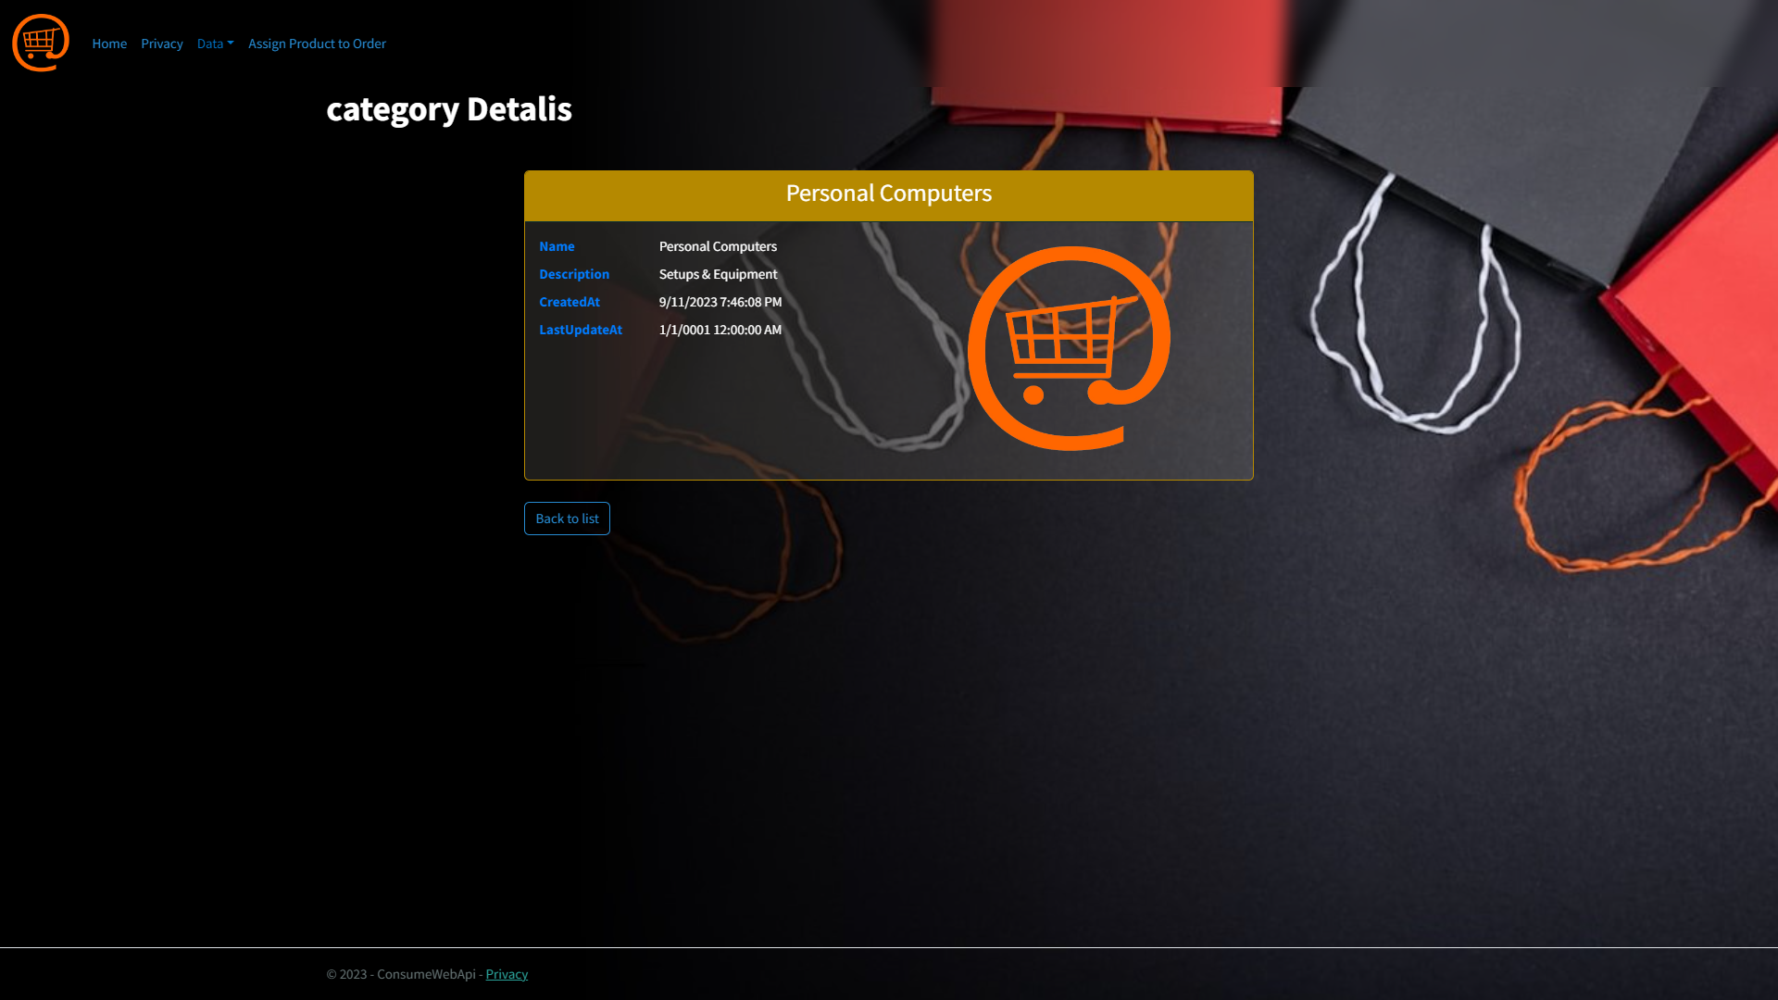
Details
Page:
You can see the details of this category.

Slide 9

Edit
Page:
You can also edit this category.

Slide 10
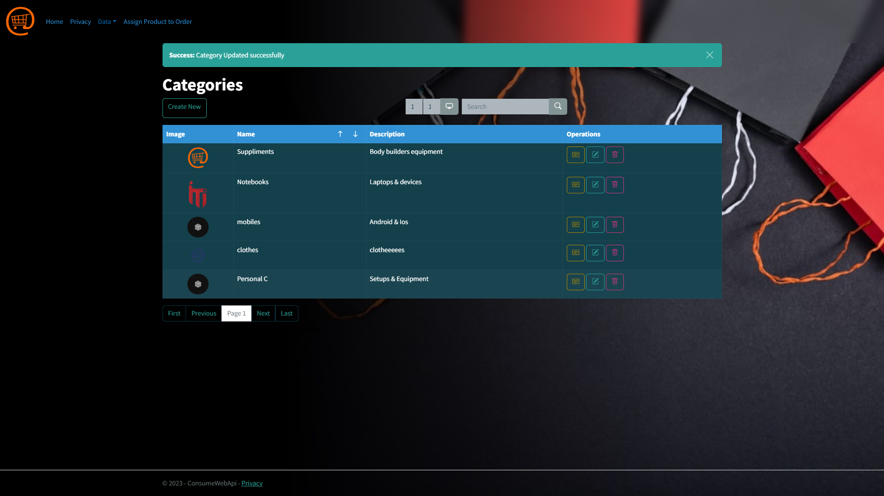
Category
Page:
After Edit Image.

Slide 11
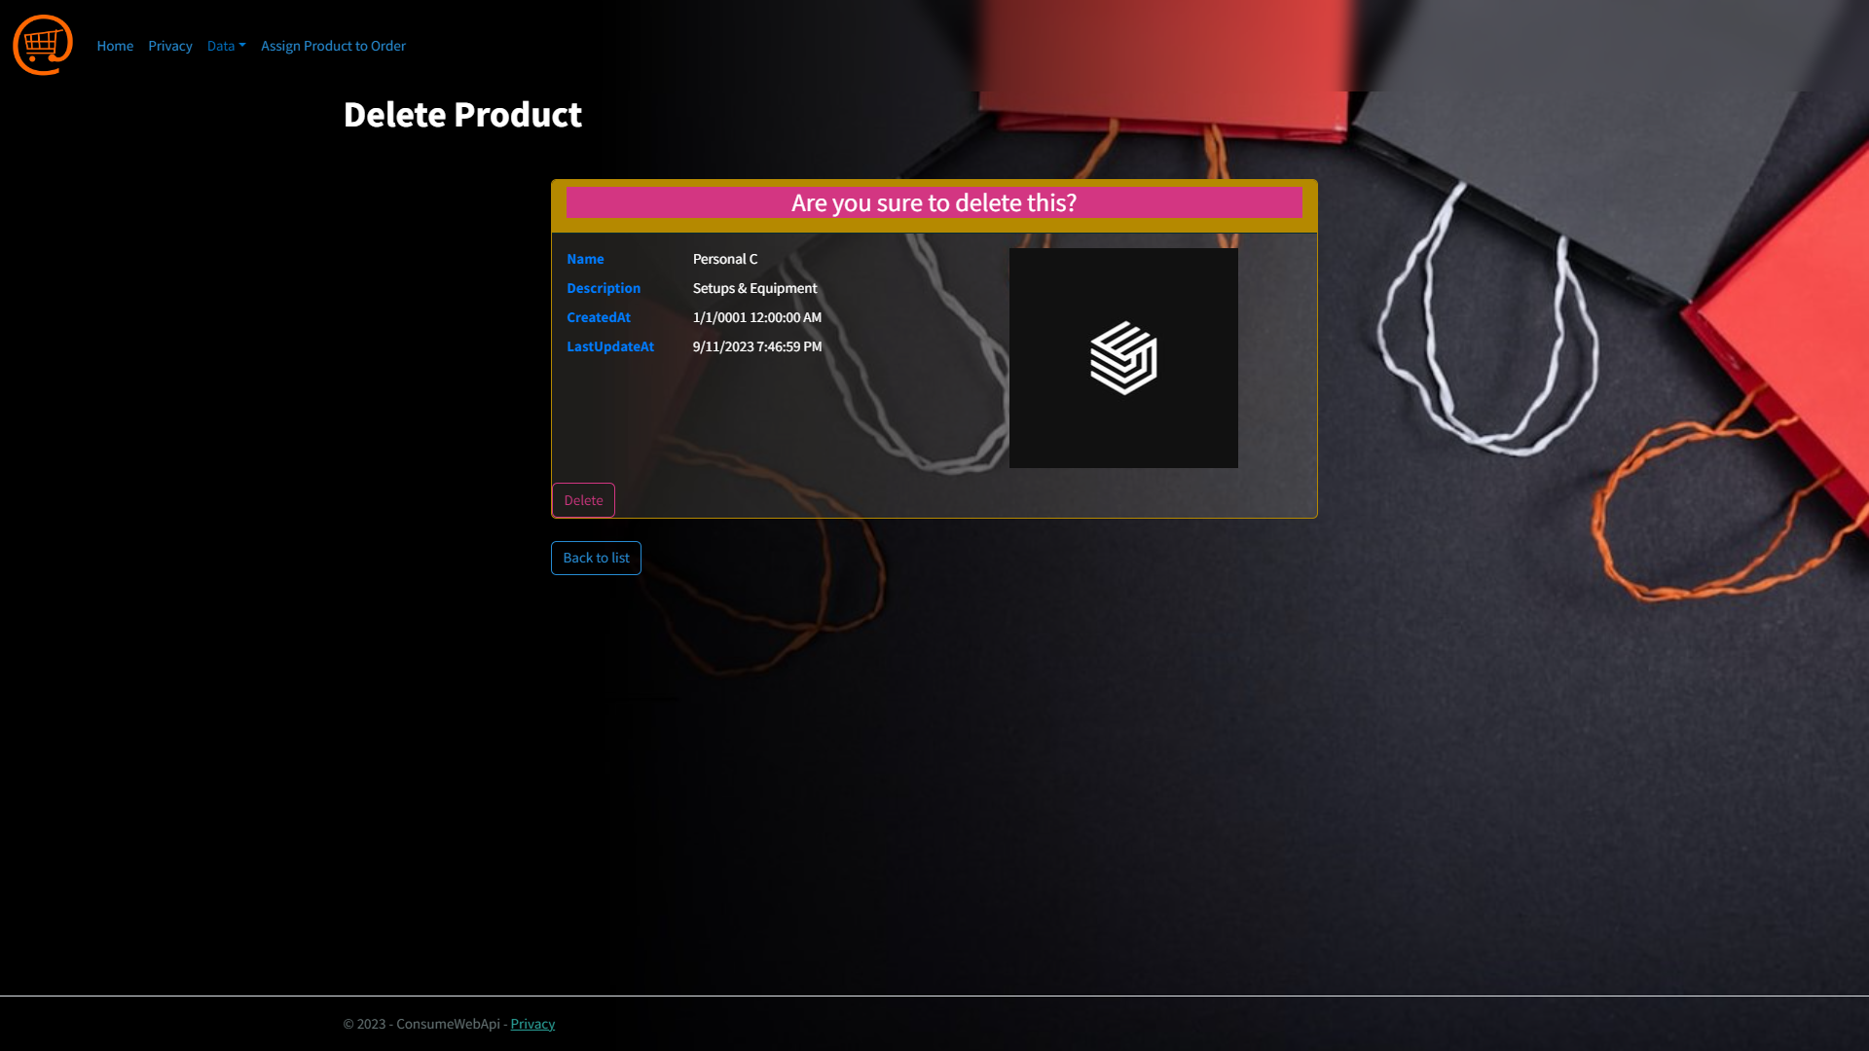
Delete
Page:
Also you can delete it.

Slide 12
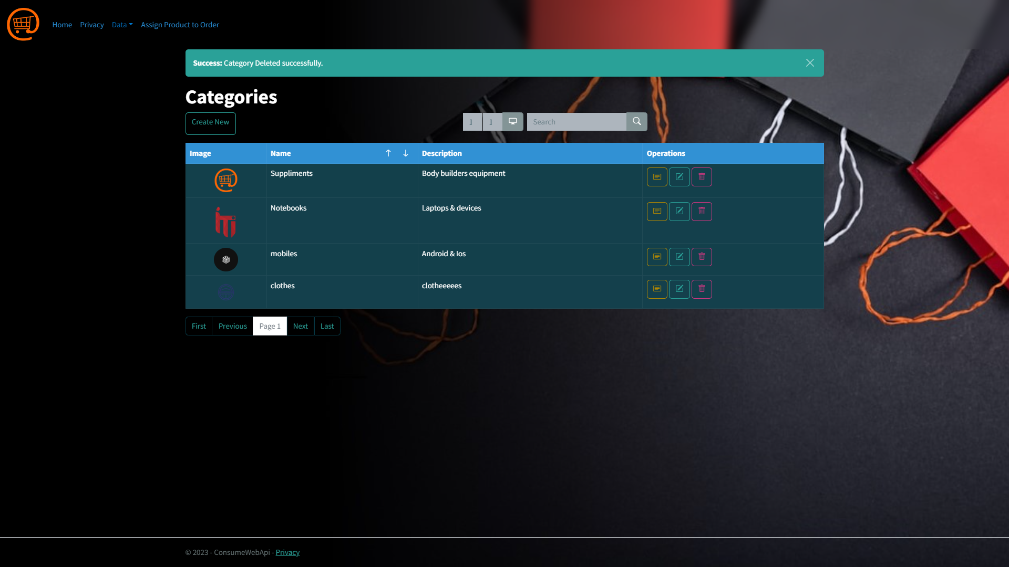
Category
Page:
After Deletion.

Slide 13
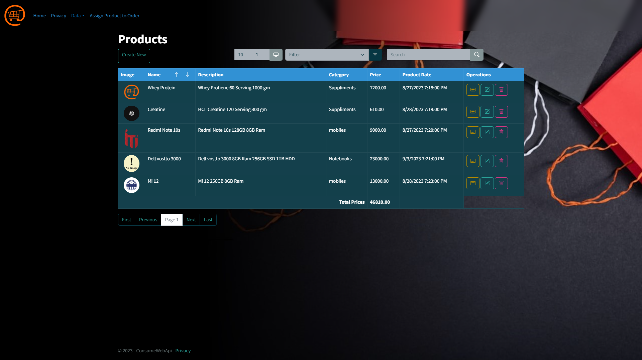
Product
Page:

Slide 14
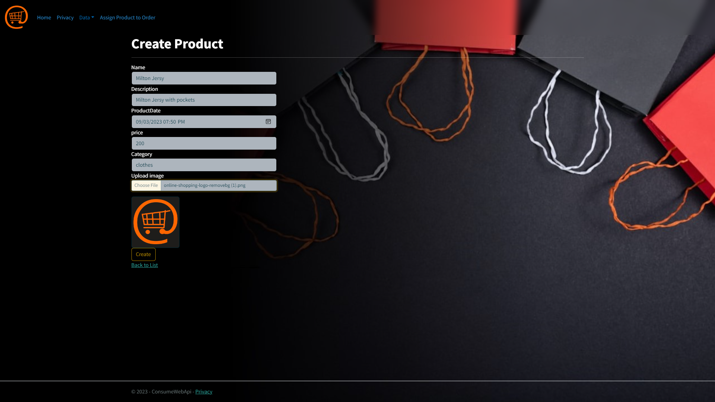
Create
Page:
Product Creation, and add category is available.

Slide 15
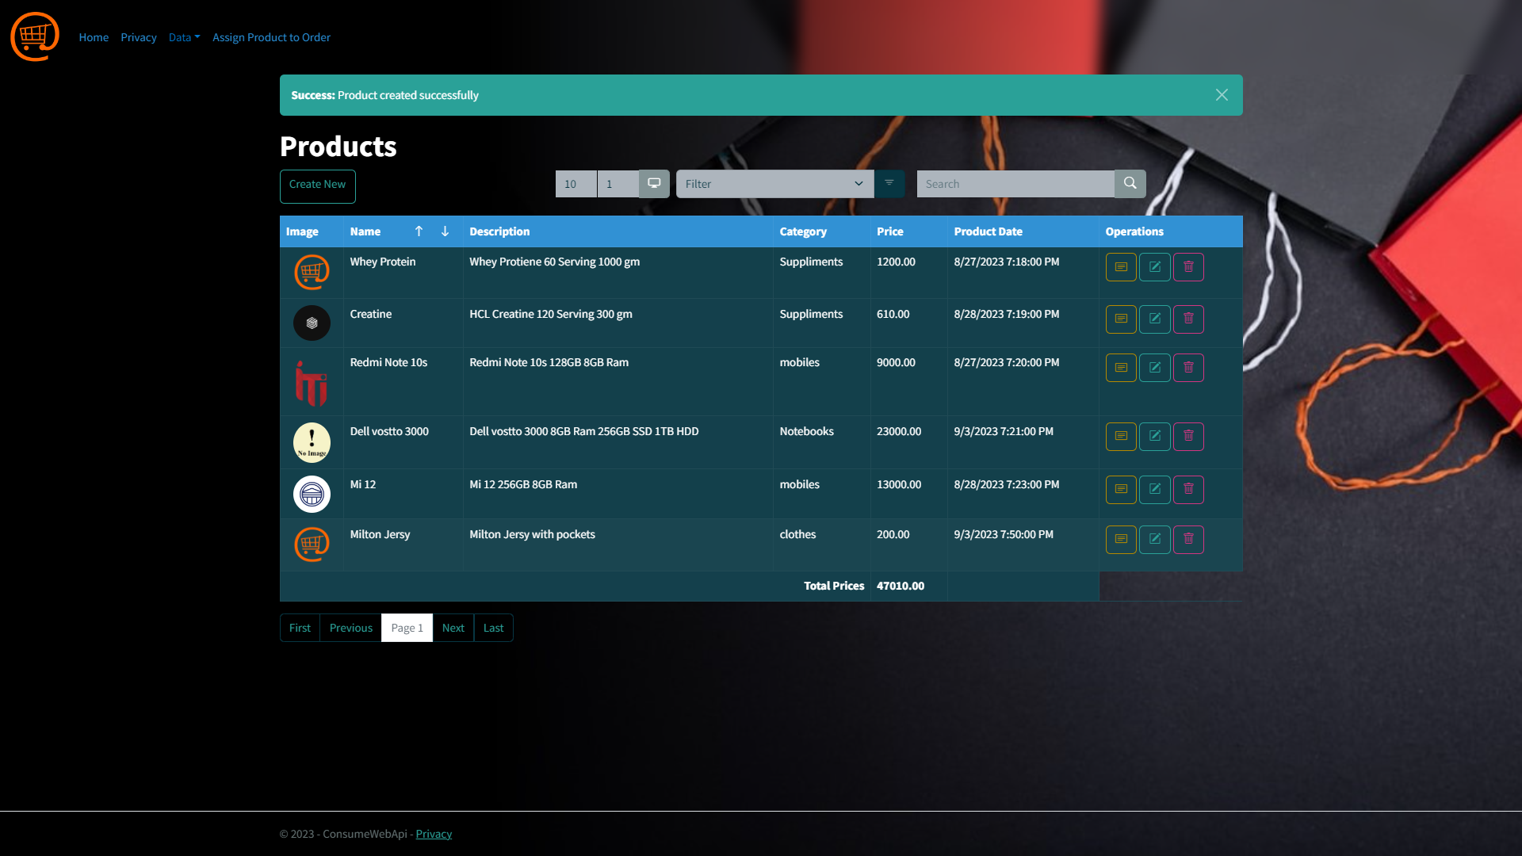
Product
Page:
After Creation.

Slide 16
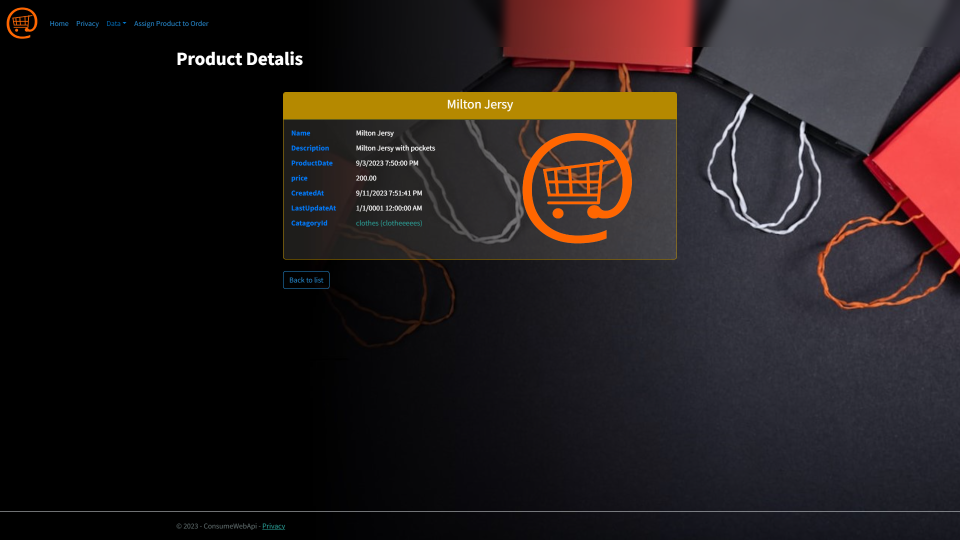
Details
Page:
We can also see the details of this product with anchor link (CategoryId) to see the category details.

Slide 17
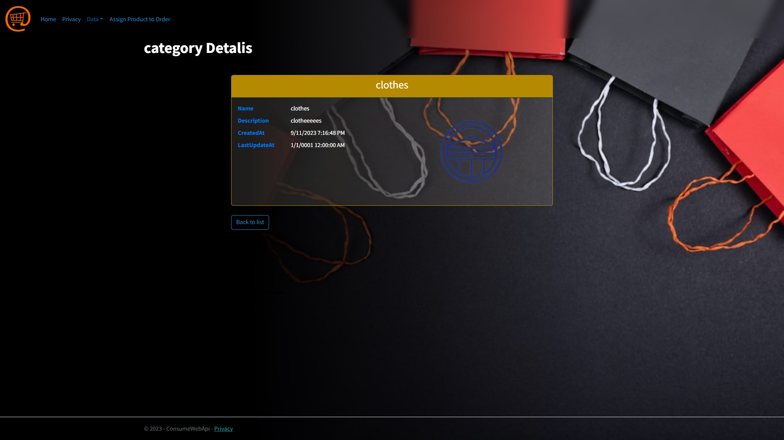
Details
Page:
As you can see here from previous page.

Slide 18
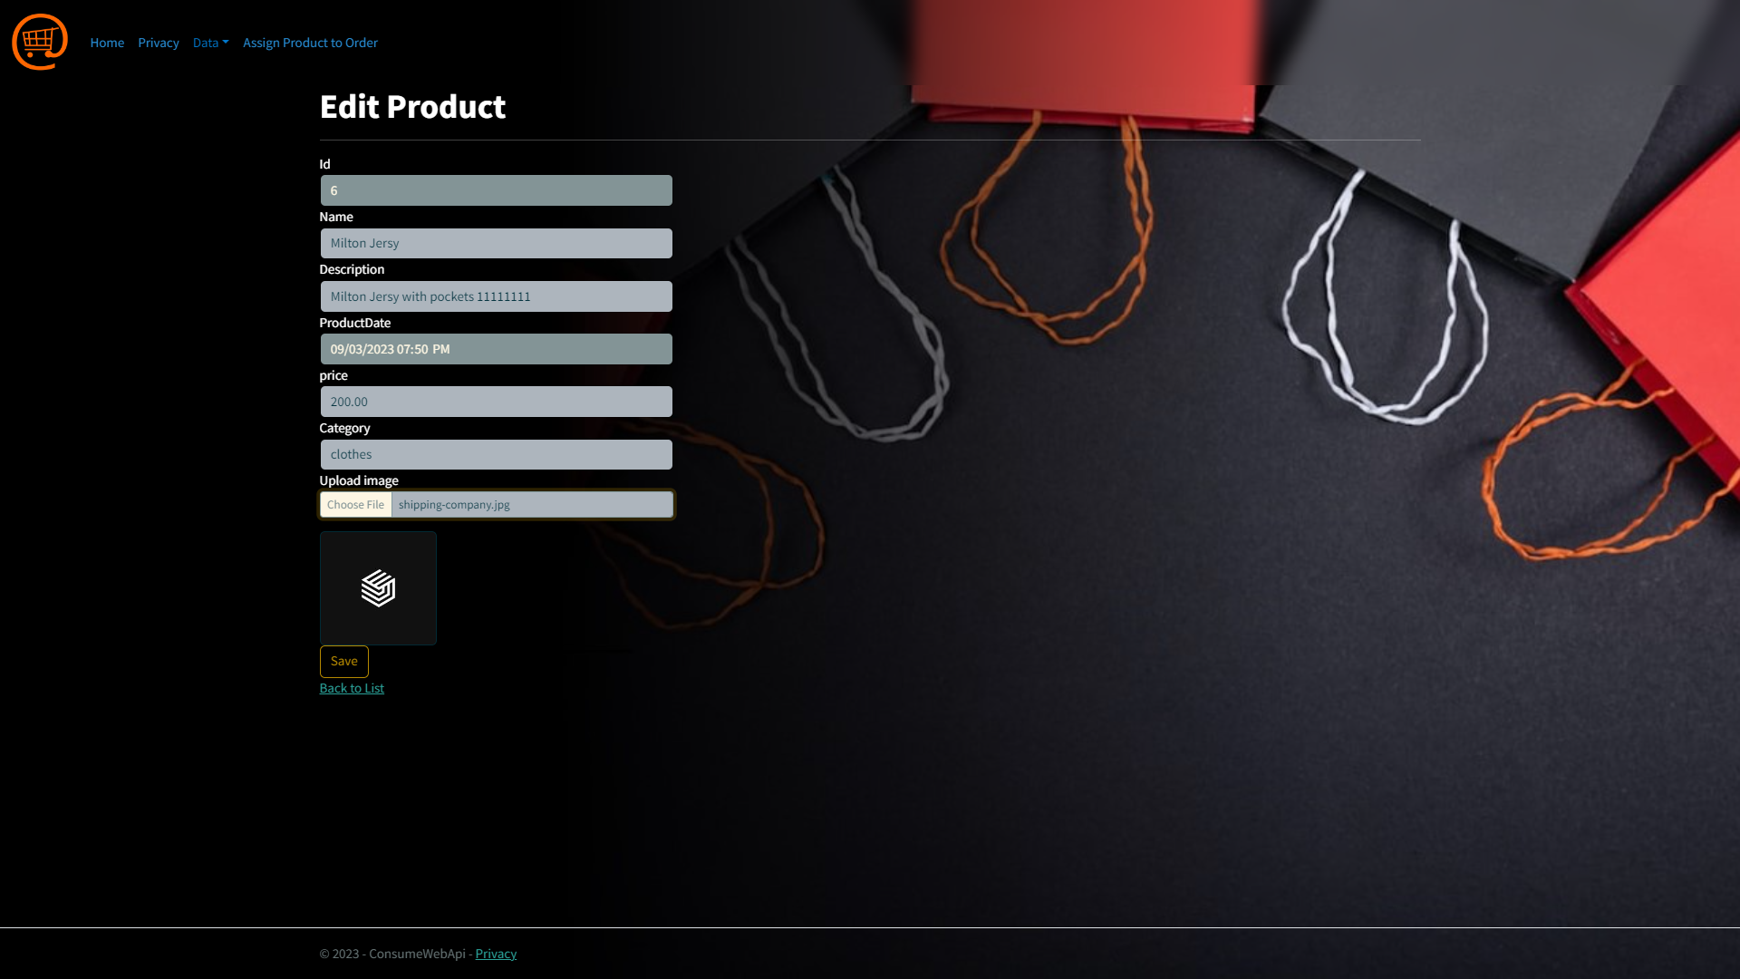
Edit
Page:
You can edit products, the id field is disabled as product date field.

Slide 19
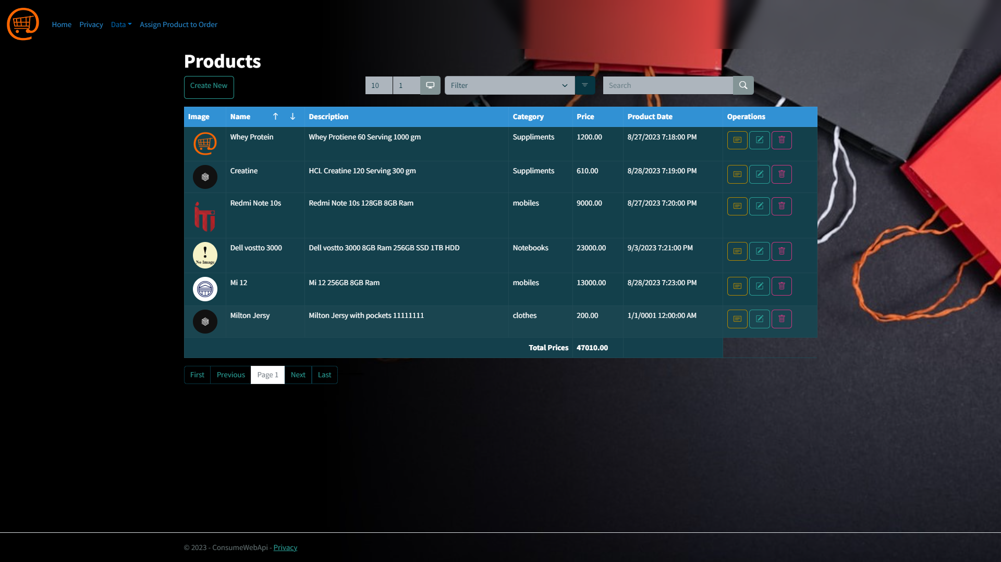
Product
Page:
After Image Replace.

Slide 20
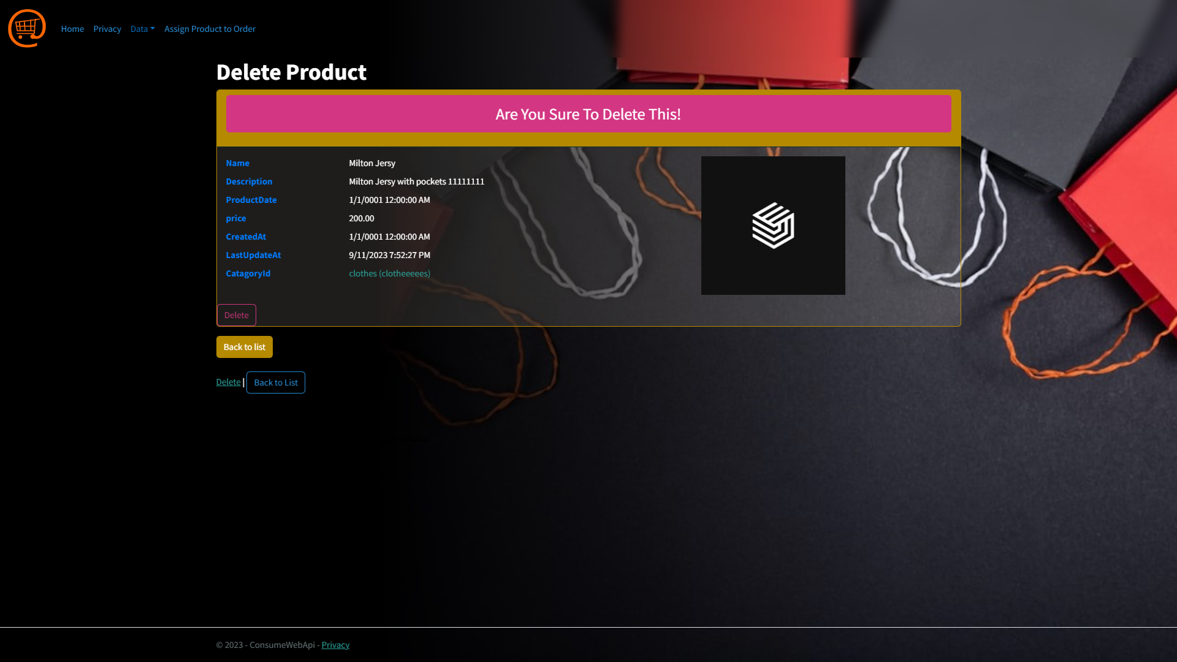
Delete
Page:
We can delete it also.

Slide 21
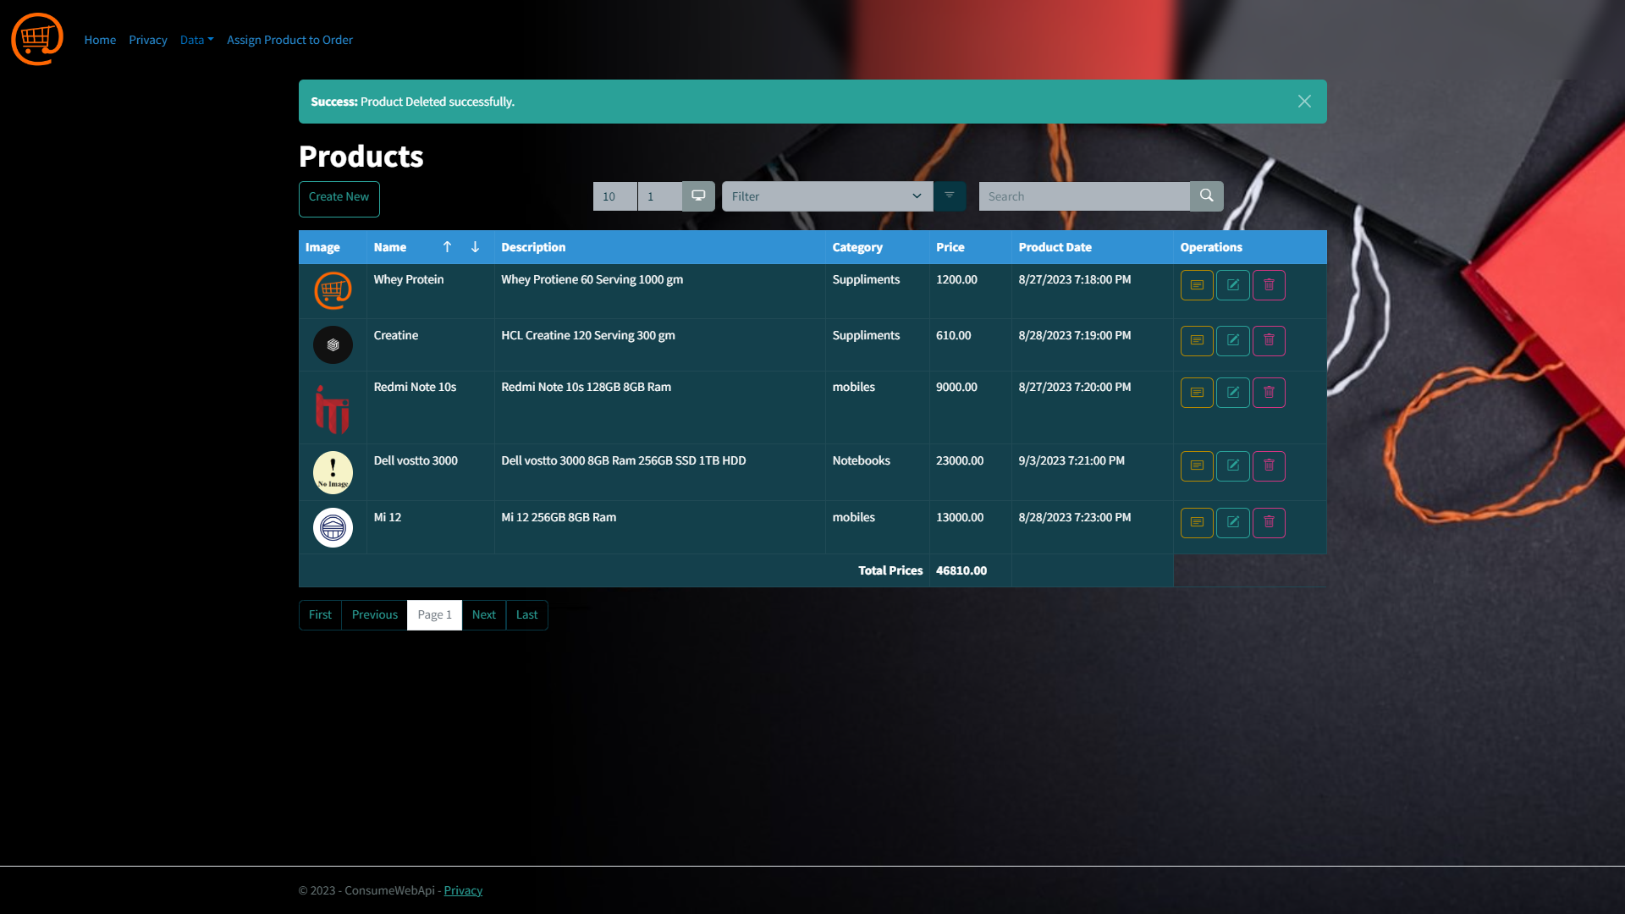
Delete
Page:
After Deletion.

Slide 22
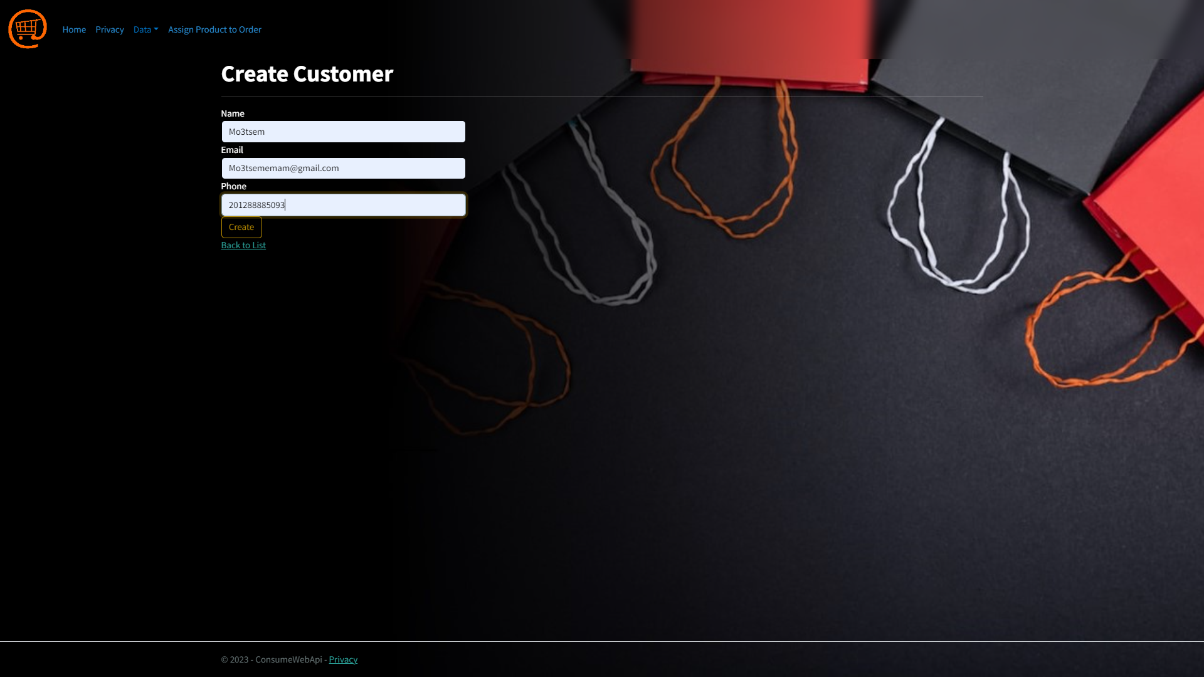
Create
Page:
You can create a customer from here.

Slide 23
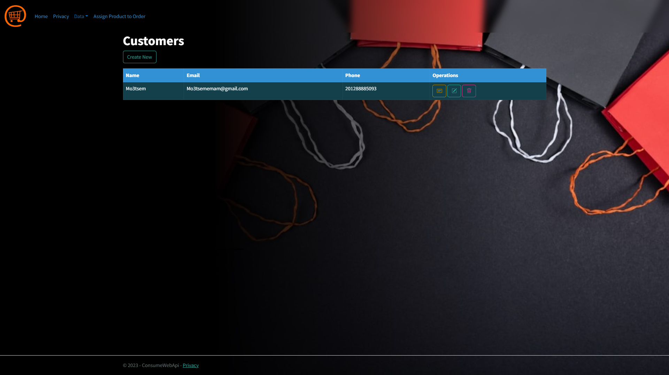
Customer
Page:
After Customer Creation.

Slide 24
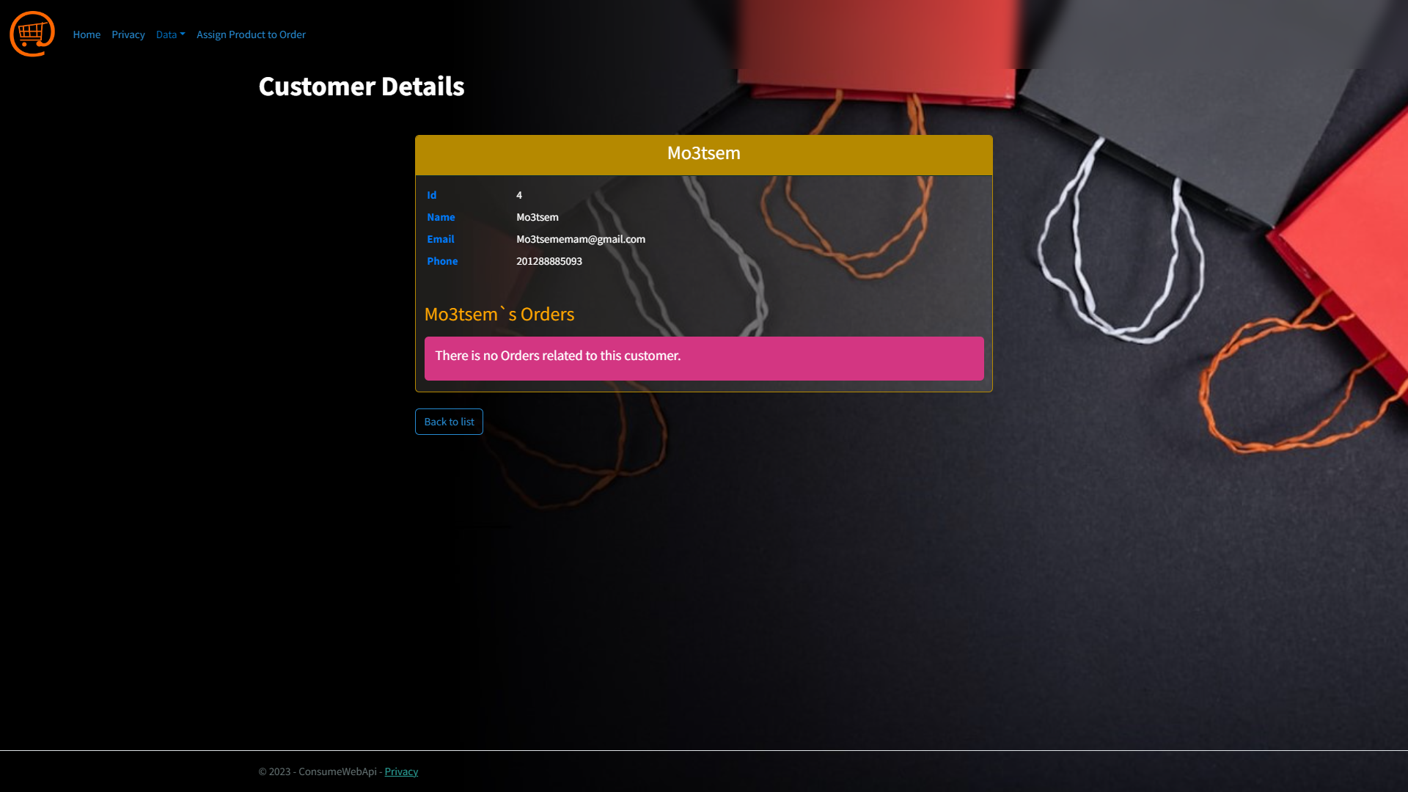
Customer
Page:
Customer details with orders related to him.

Slide 25
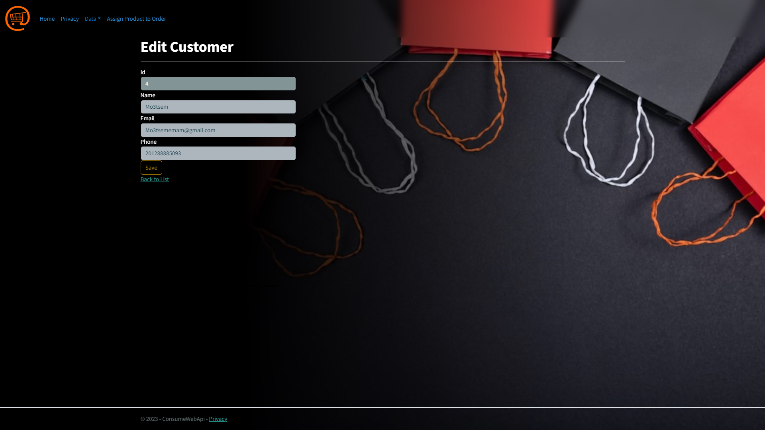
Edit
Page:

Slide 26

Delete
Page:

Slide 27
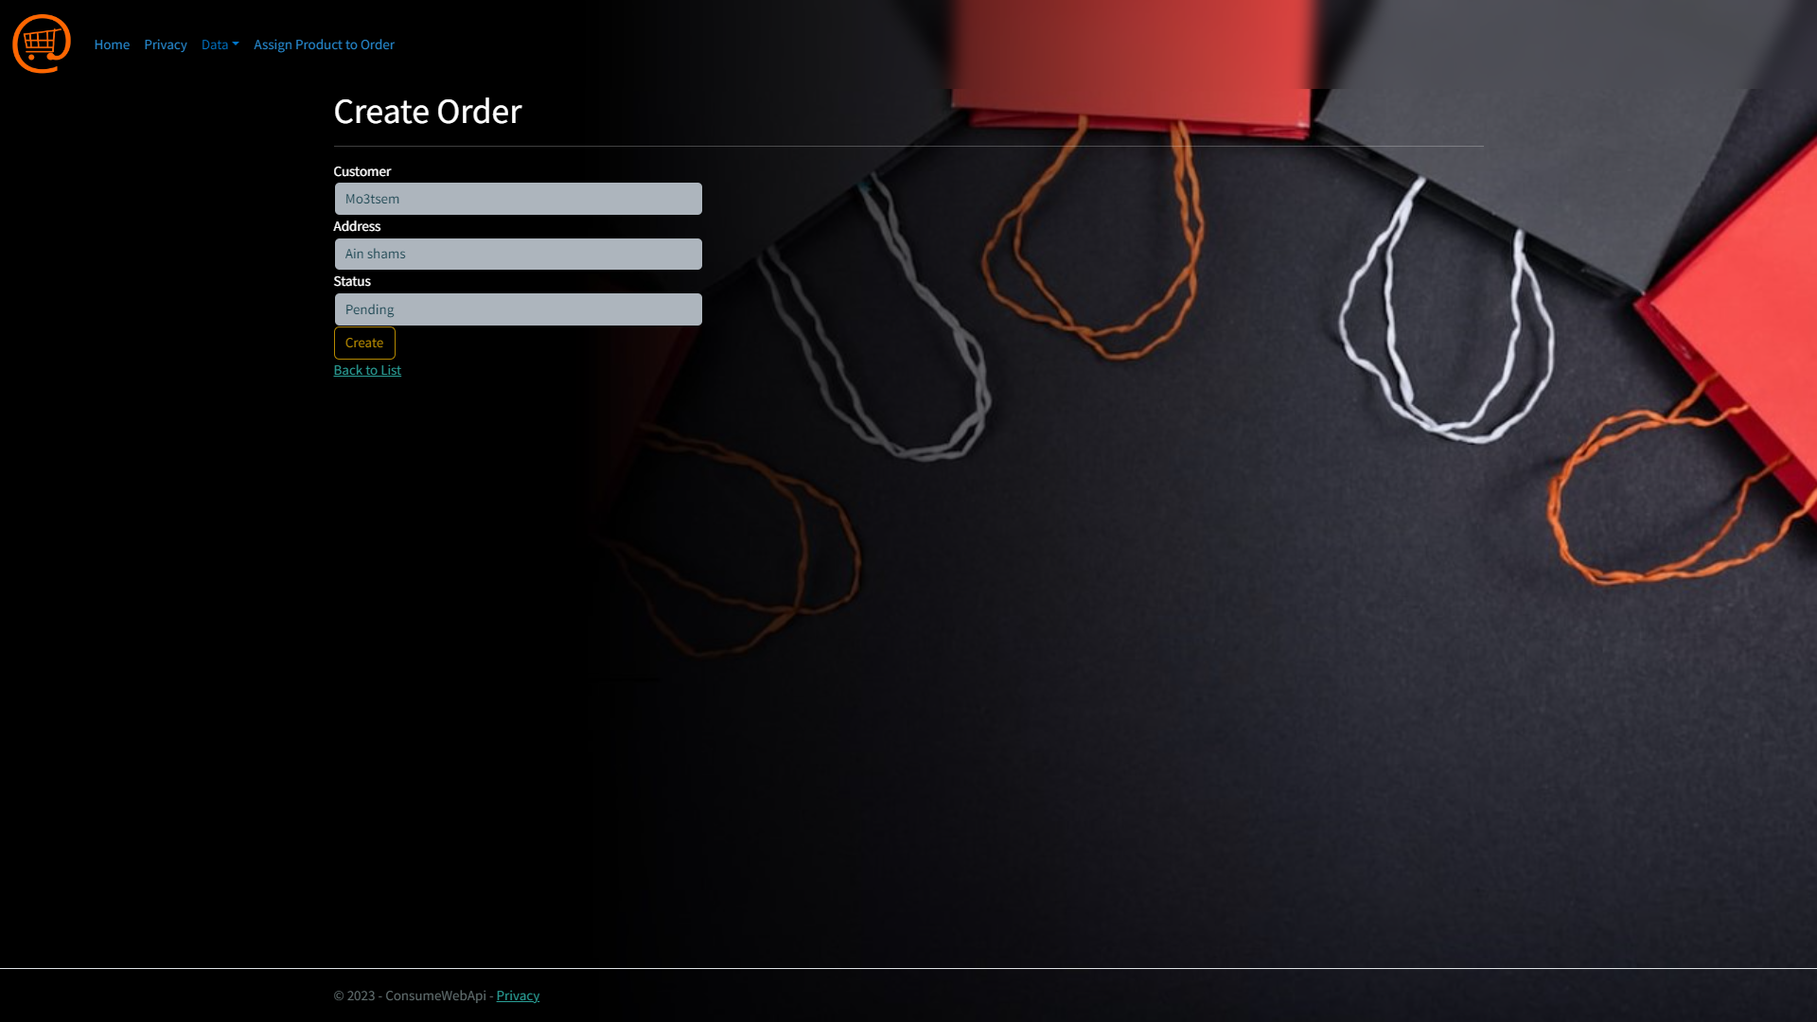
Create
Page:
We can create an order from here.

Slide 28
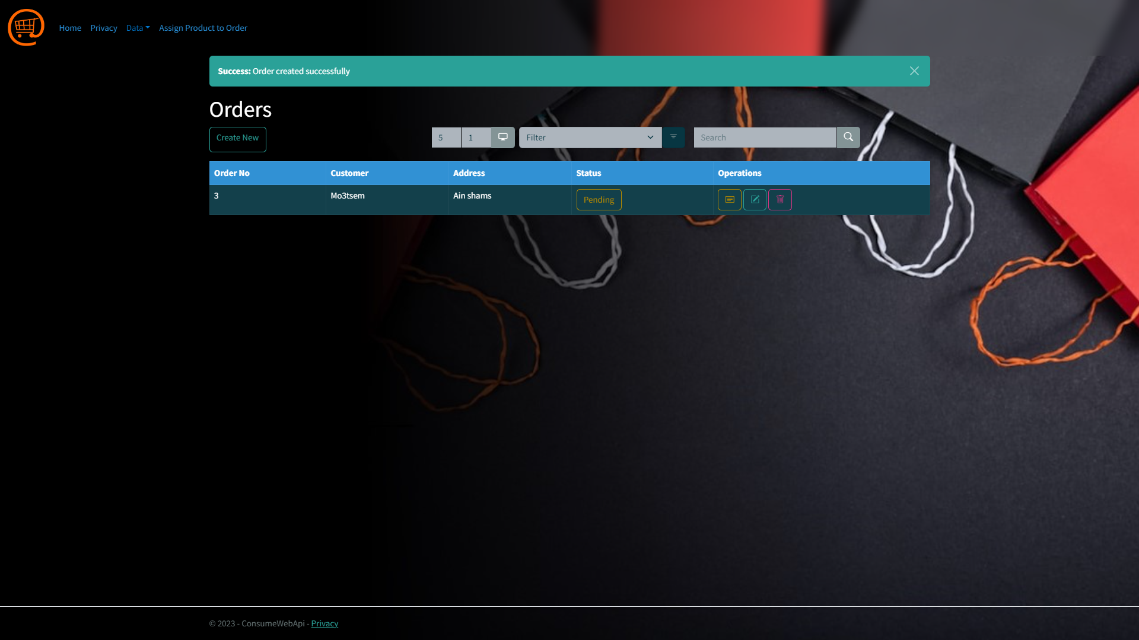
Order
Page:
After Order creation.

Slide 29
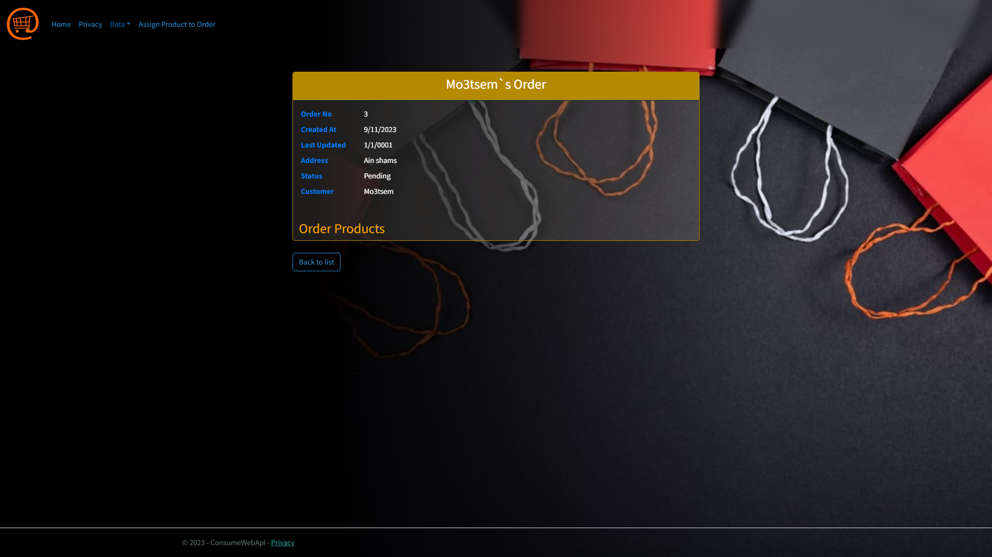
Details
Page:

Slide 30
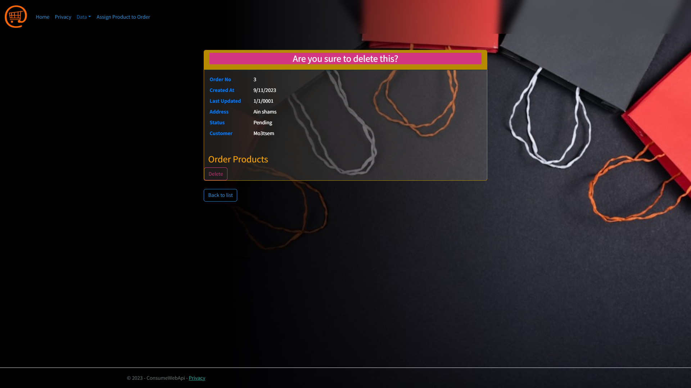
Delete
Page:

Slide 31
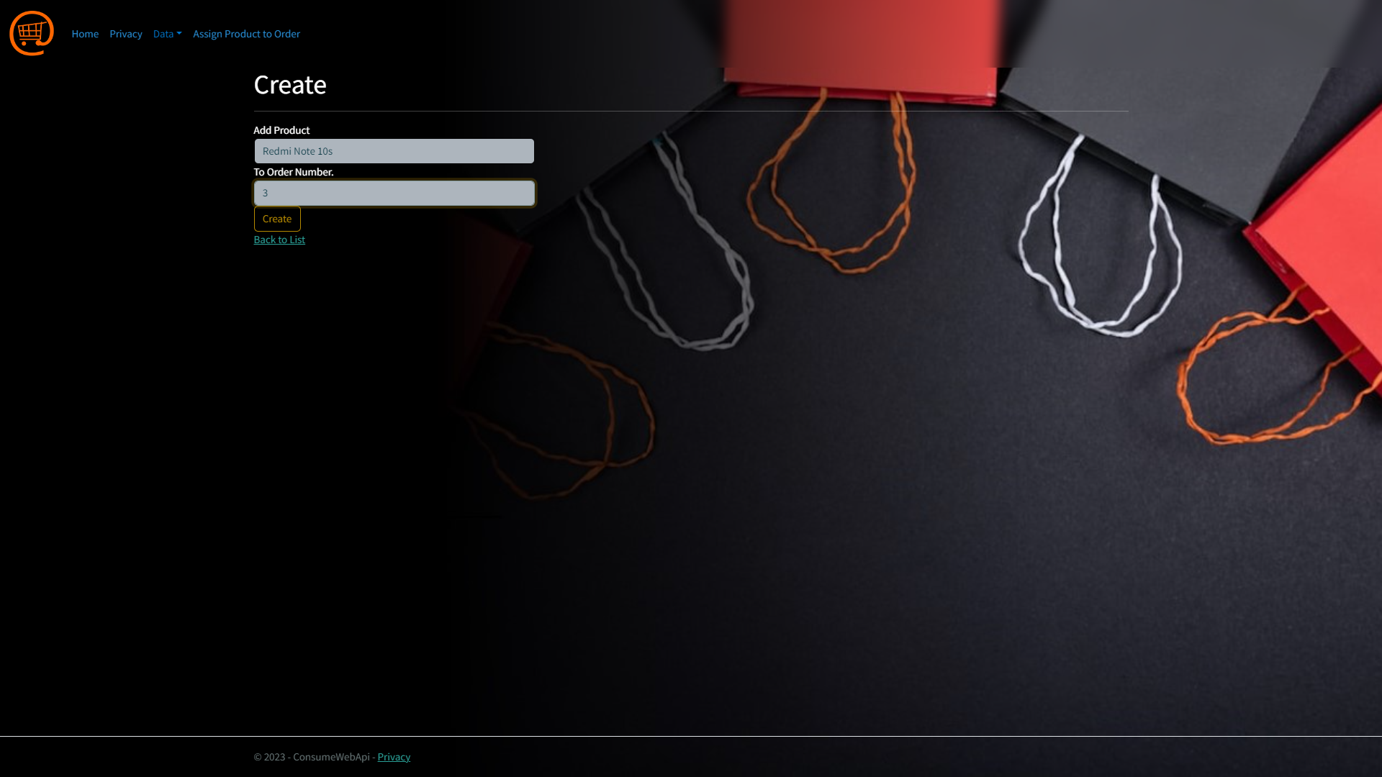
Assign
Page:
This is the final and important step, as we can add products to many order and vise versa.

Slide 32
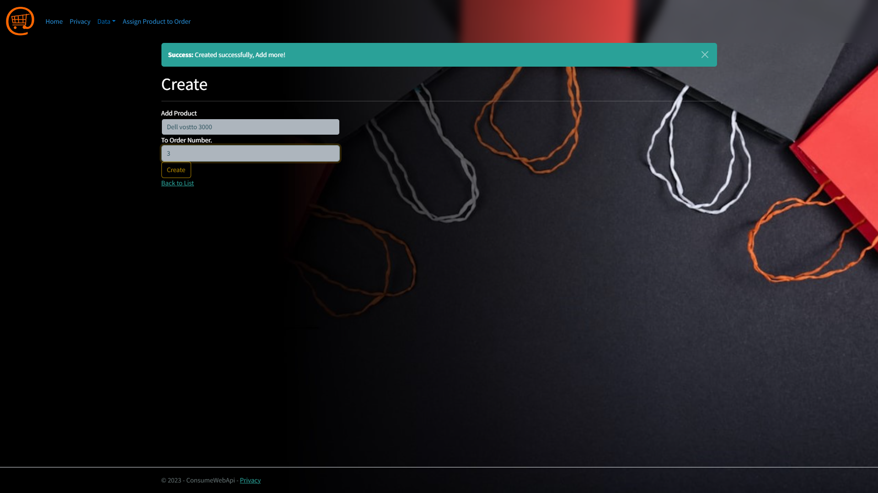
Assign
Page:
After completion, the redirect action is to the same view with message (Add more!) to let the user use many to many to features.

Slide 33
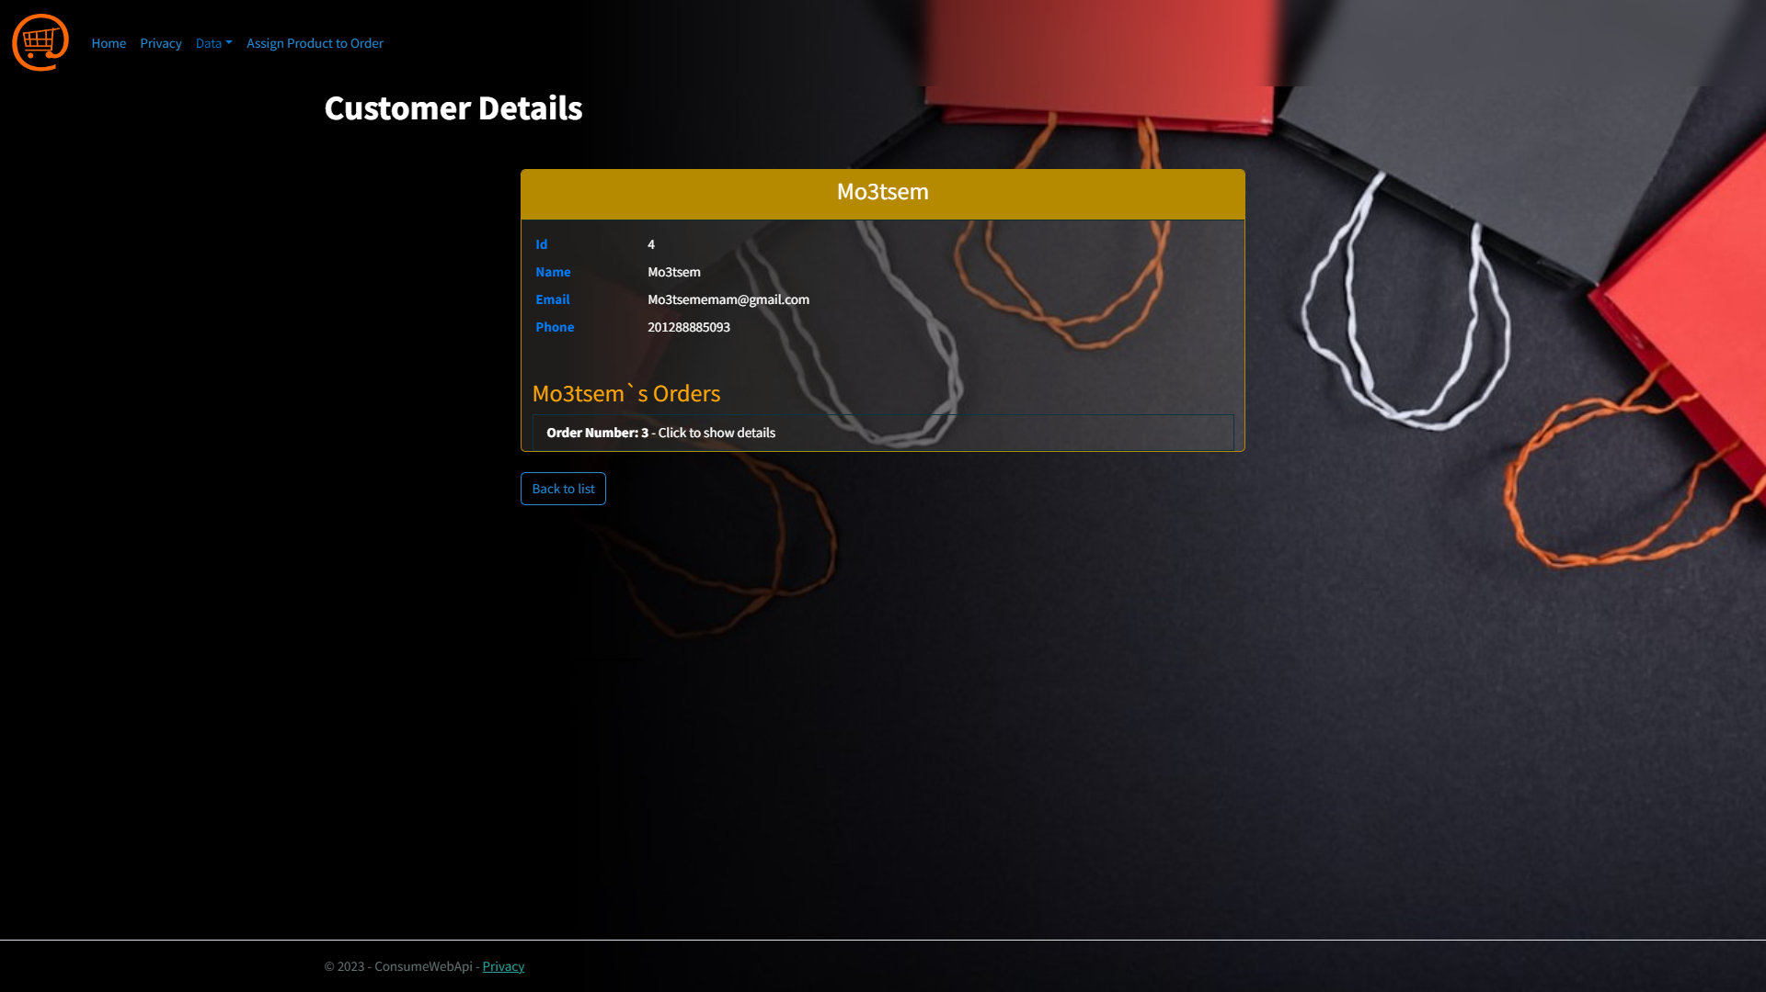
Details
Page:
After adding many products to the order that related to mo3tsem, we can see the details of this customer with his orders.

Slide 34
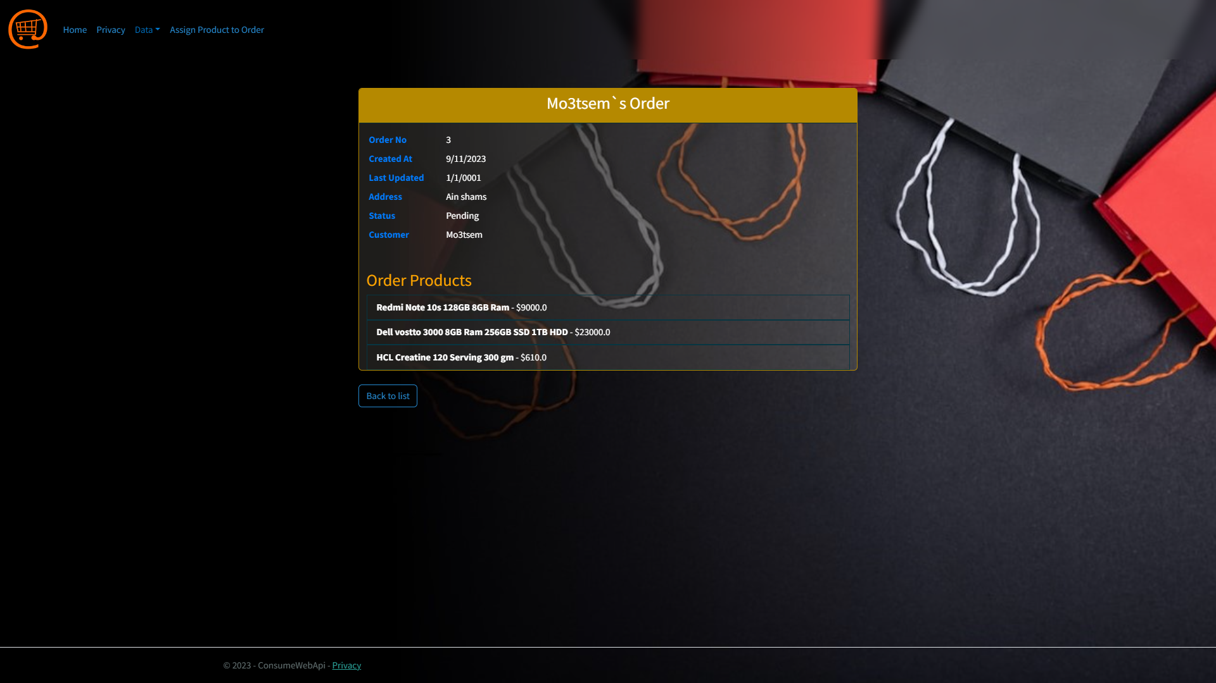
Details
Page:
Also we can view the order details by clicking on it, as you can do here to view the product details.

Slide 35


